Slide 1
PREDICTION OF ENERGY PRODUCTION FOR COMBINED CYCLE POWER PLANT
BY :
CHANNABASAVA
SIDDESHWAR PRASAD
KARTHIK G
SAPNA SANDU SURASE
AISHWARAYA Ighepatil
KALLURI MAHESH
ANGITHA P

Slide 2
Architecture
Understanding business objective
Exploratory Data Analysis
Model Building
Model Evaluation
Deployment

Slide 3
Business objective
A combined-cycle power plant comprises gas turbines, steam turbines, and heat recovery steam generators. In this type of plant, the electricity is generated by gas and steam turbines combined in one cycle. Then, it is transferred from one turbine to another. We have to model the energy generated as a function of exhaust vacuum and ambient variables and use that model to improve the plant's performance.

Slide 4
The variables are the following:
Temperature, in degrees Celsius.
Exhaust vacuum, in cm Hg. ( 76 cm Hg means at normal temp (25 C) and pressure , the height of the mercury column supported by the atmospheric pressure at the place is 76 cm )
Ambient pressure, in millibar. ( The ambient pressure on an object is the pressure of the surrounding medium in contact with the object. )
In this dataset it ranges from 900-1050 millibar.
Relative humidity, in percentage. ( It refers to the moisture content of the atmosphere expressed as a percentage of the amount of the moisture that can be retained by the atmosphere at a given temperature and pressure without condensation. )
Energy production, in MW, net hourly electrical energy output.

Slide 5
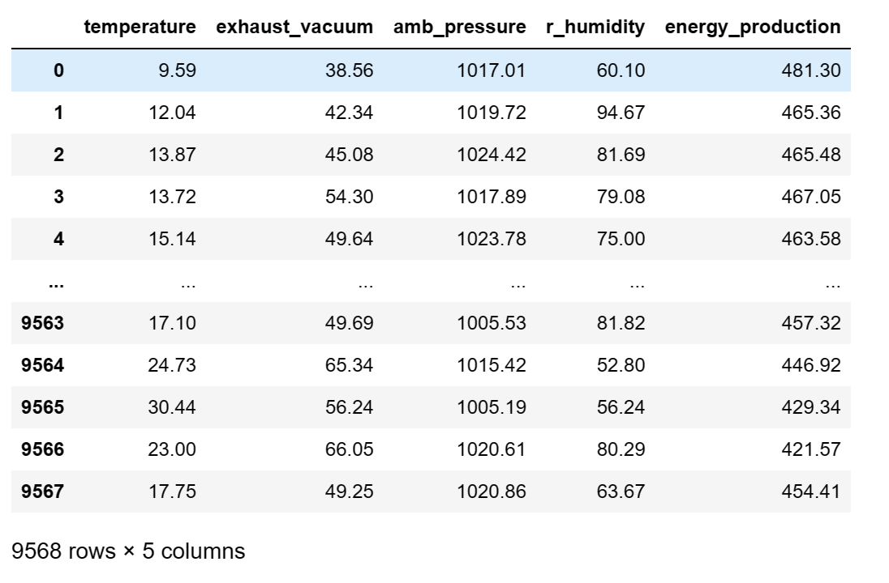
Data set

Slide 6
From EDA
The given dataset has no null values.
The data types are floating point data types.
We have found 41 duplicate values on the dataset and we have removed them.
We found outliners in ambient pressure and R_Humidity which have been removed.
From the dataset we have found that Energy production is a dependent variable.
Independent variables are Temperature, Relative Humidity, Ambient pressure, Exhaust vacuum.

Slide 7
Skewness and correlation
Independent variables, Temperature and Relative humidity are negatively skewed or left skewed.
Where as Exhaust vacuum and Ambient pressure are positively skewed or right skewed.
Dependent variable Energy production is positively skewed or right skewed.
Temperature and Exhaust vacuum are highly correlated.
We have normalize the data, we put the normalized independent variables in x variable and dependent normalized variable in y variable.

Slide 8
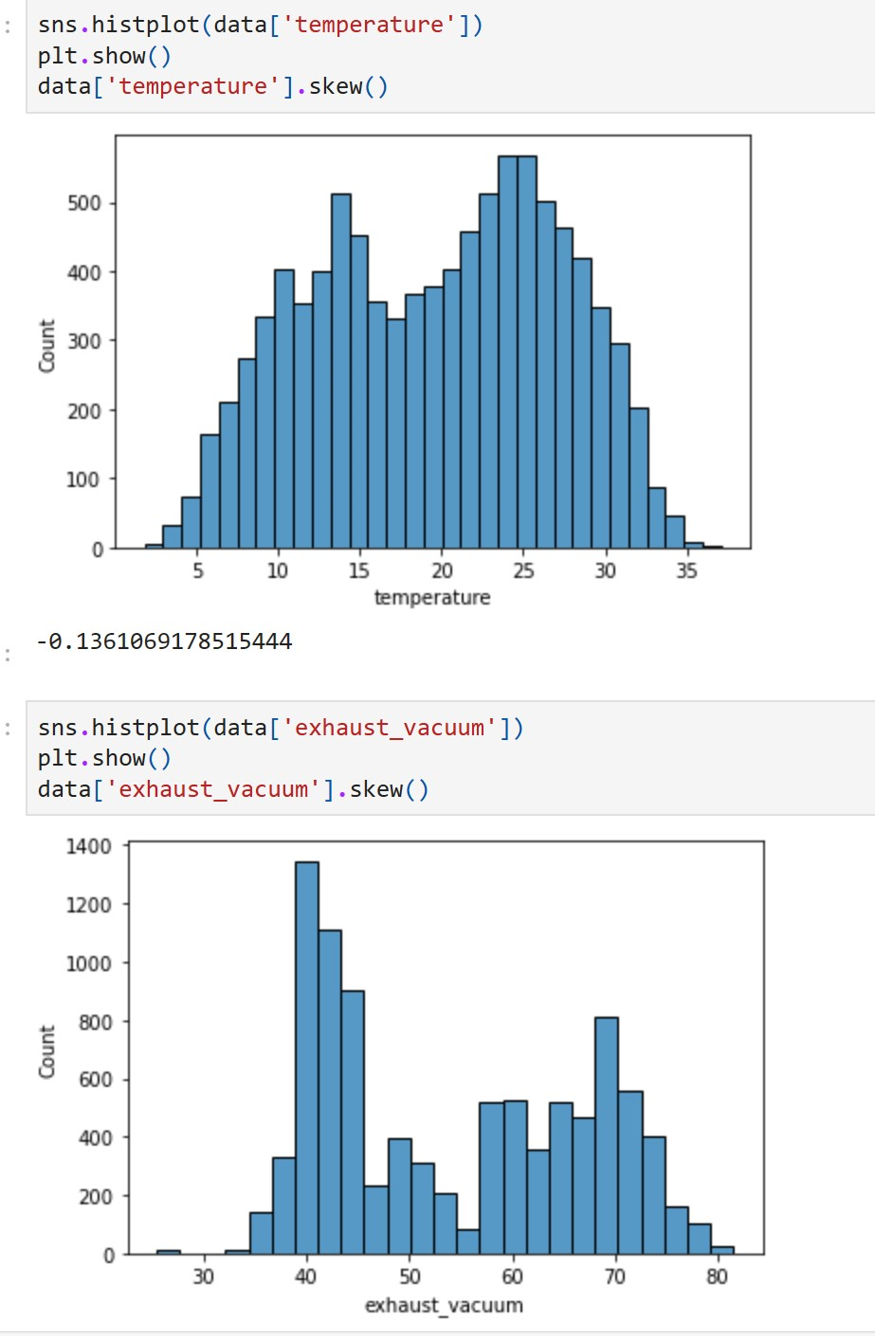

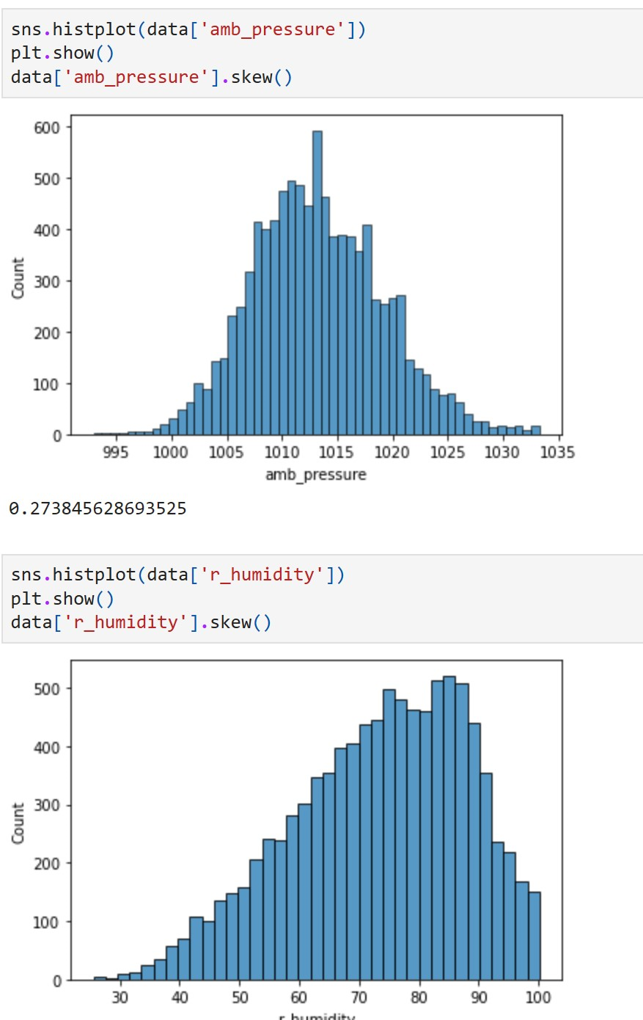
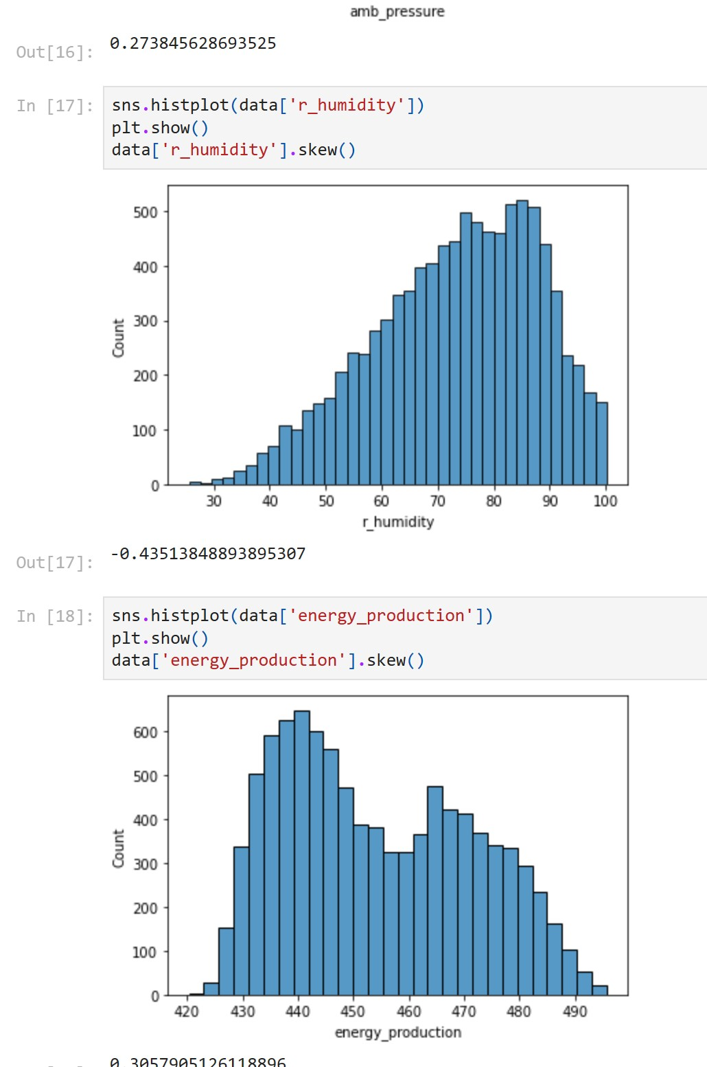
Visualization : histplot

Slide 9
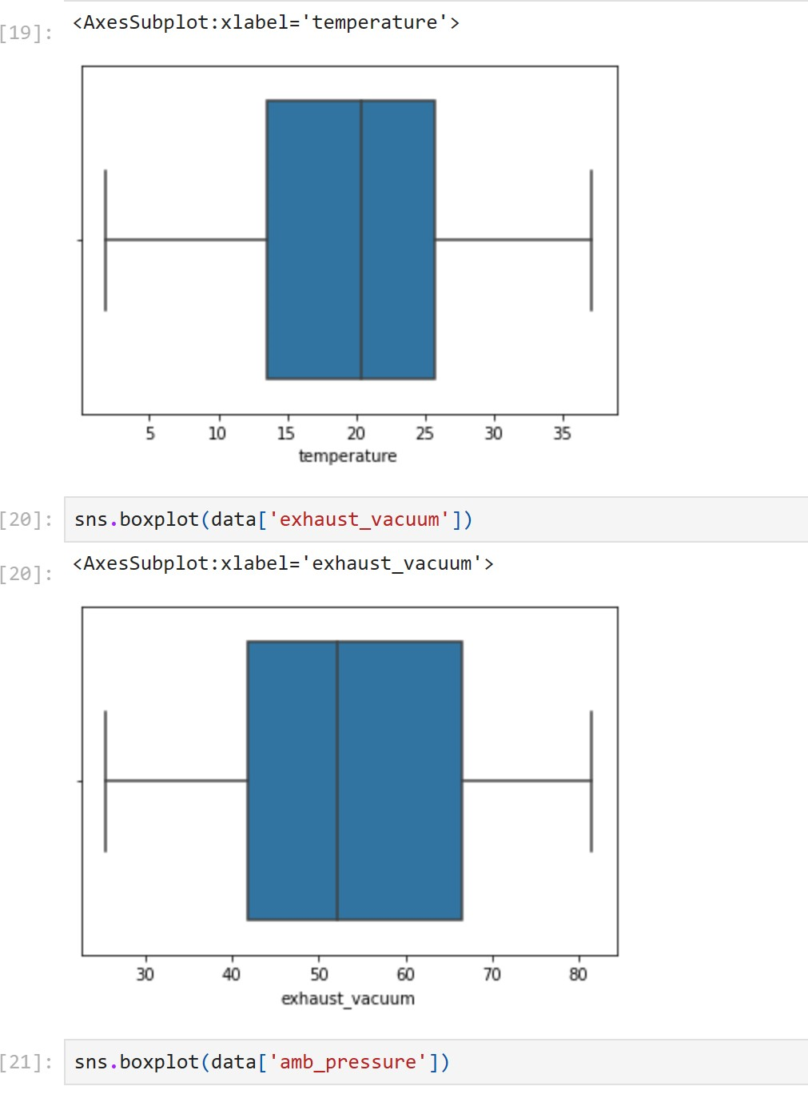
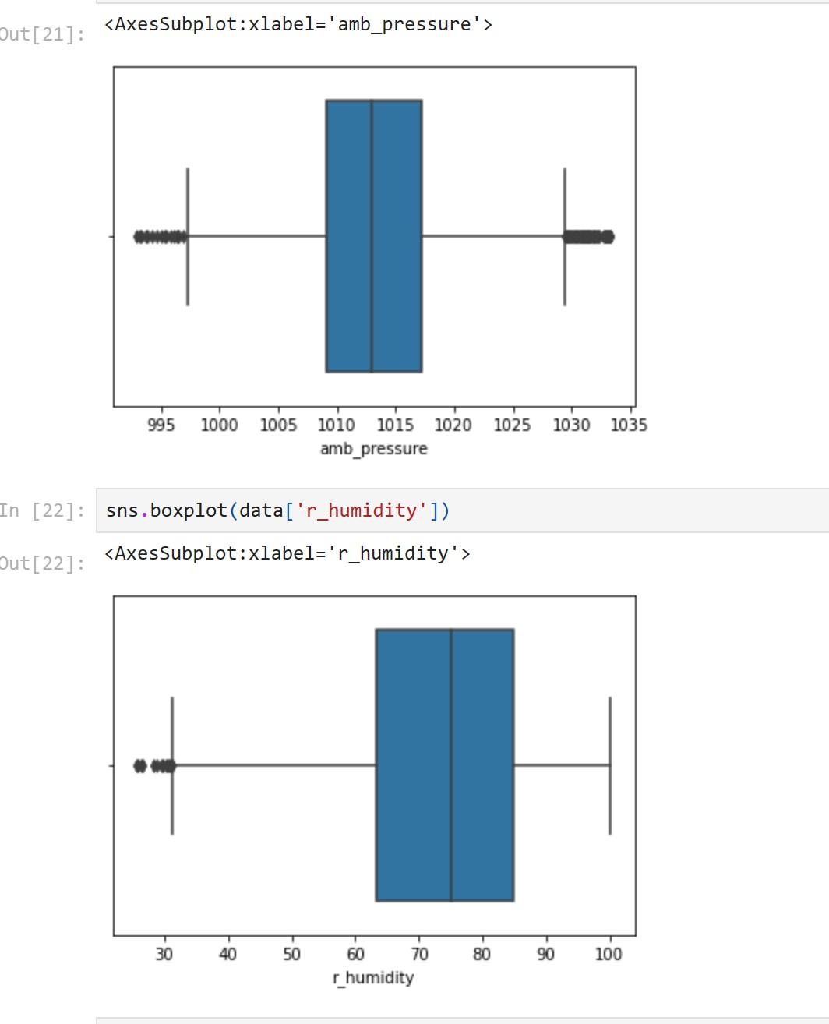
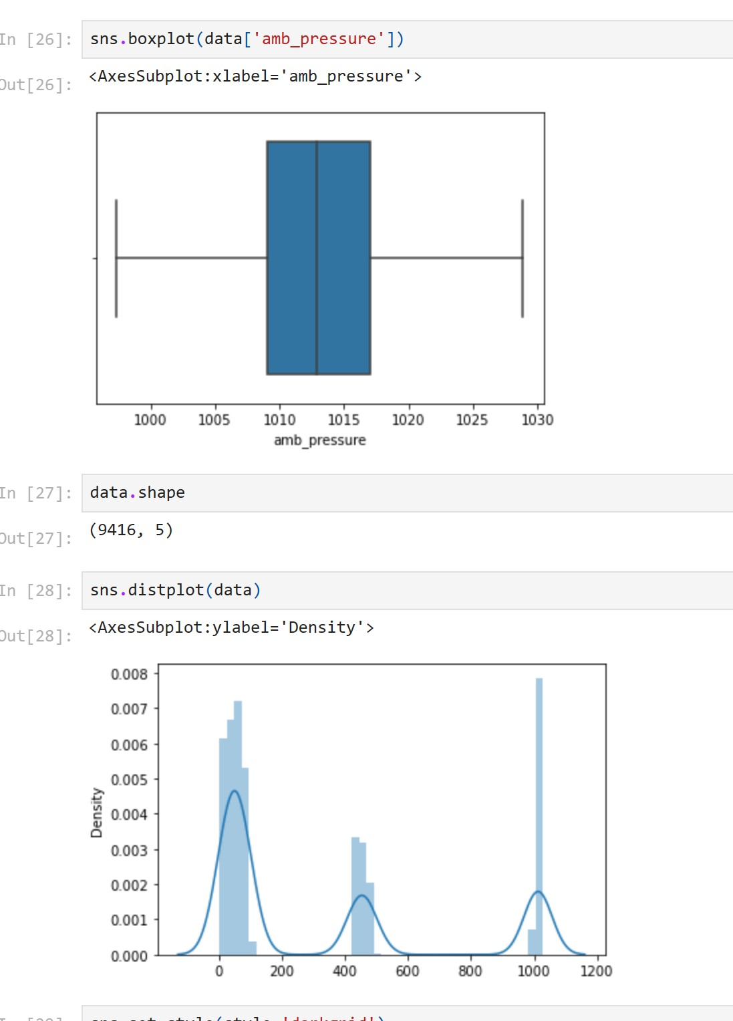
Boxplot

Slide 10
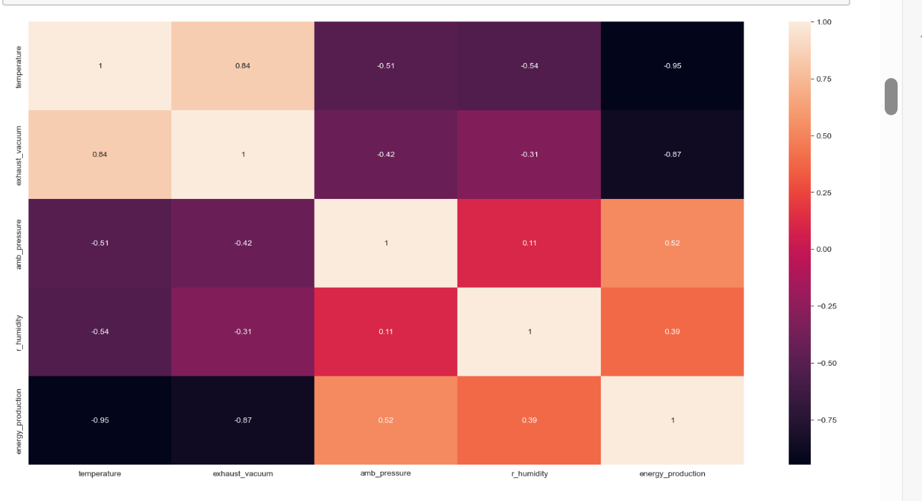
Heatmap
The temperature and exhaust vacuum have a strong negative correlation with the target variable as their correlation coefficients are -0.95 and -0.87.
Amb pressure and r humidity have a weak positive correlation with energy production with correlation coefficients of 0.52 and 0.39.

Slide 11
Correlation among the variables:
From these scatter plots, temperature shows the strongest linear relationship (negative) with the hourly electrical energy output.
Exhaust vacuum appears to have a linear relationship(negative),though at a lesser extent.
The ambient pressure seems to have a weak linear(positive) correlation with the output.
Relative humidity appears to have little(positive)to no impact on the output.

Slide 12
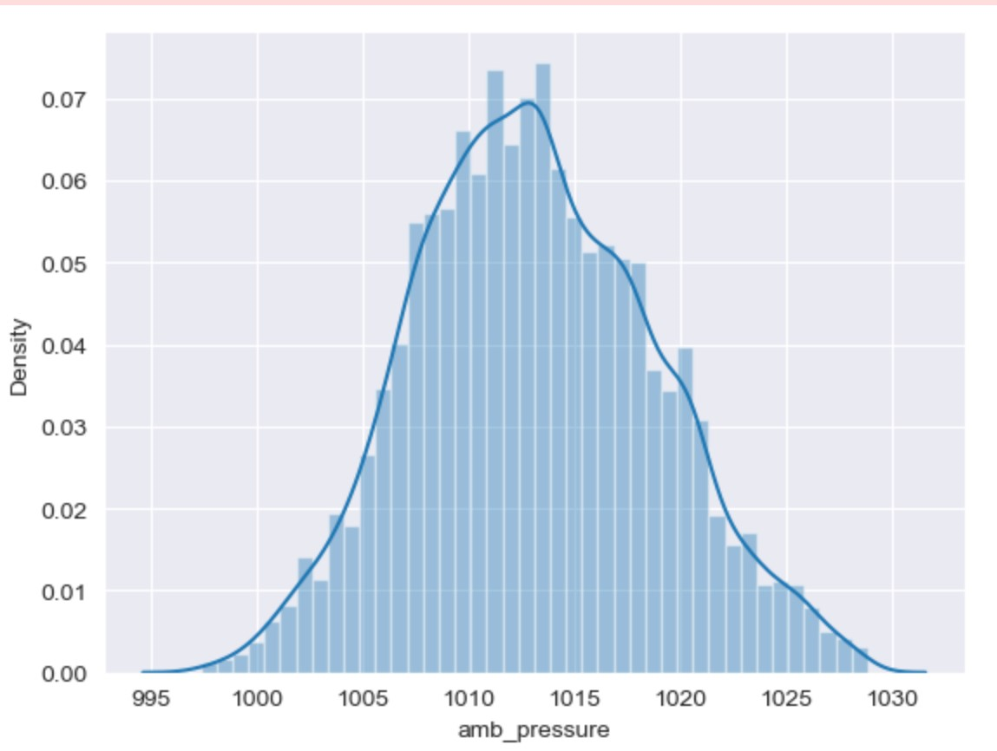
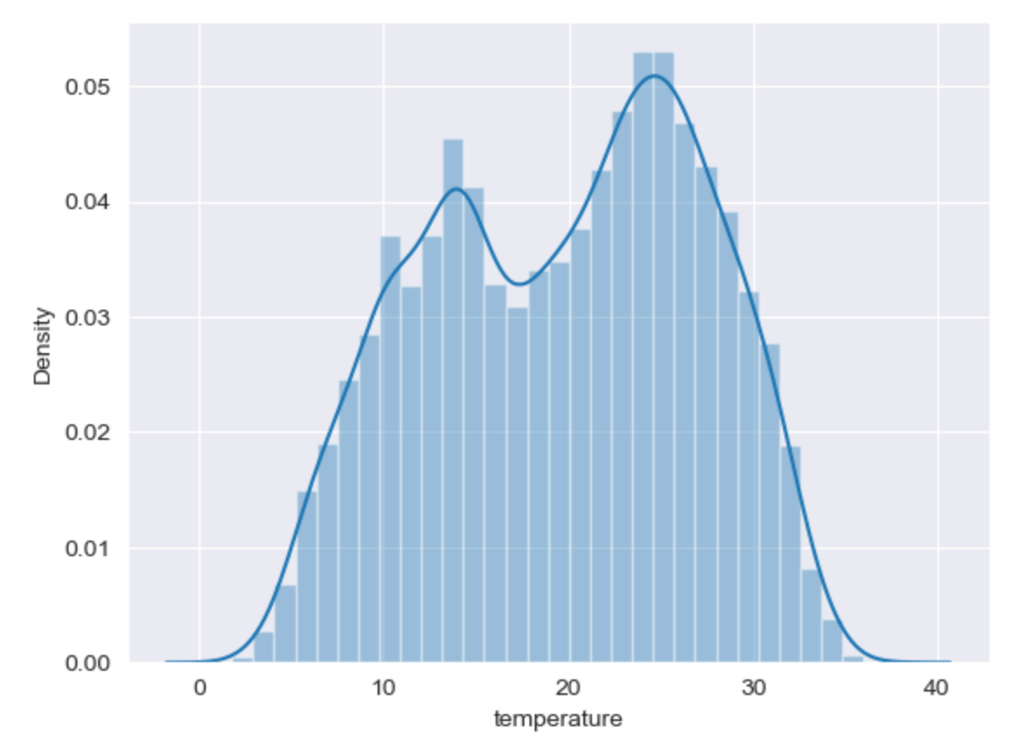
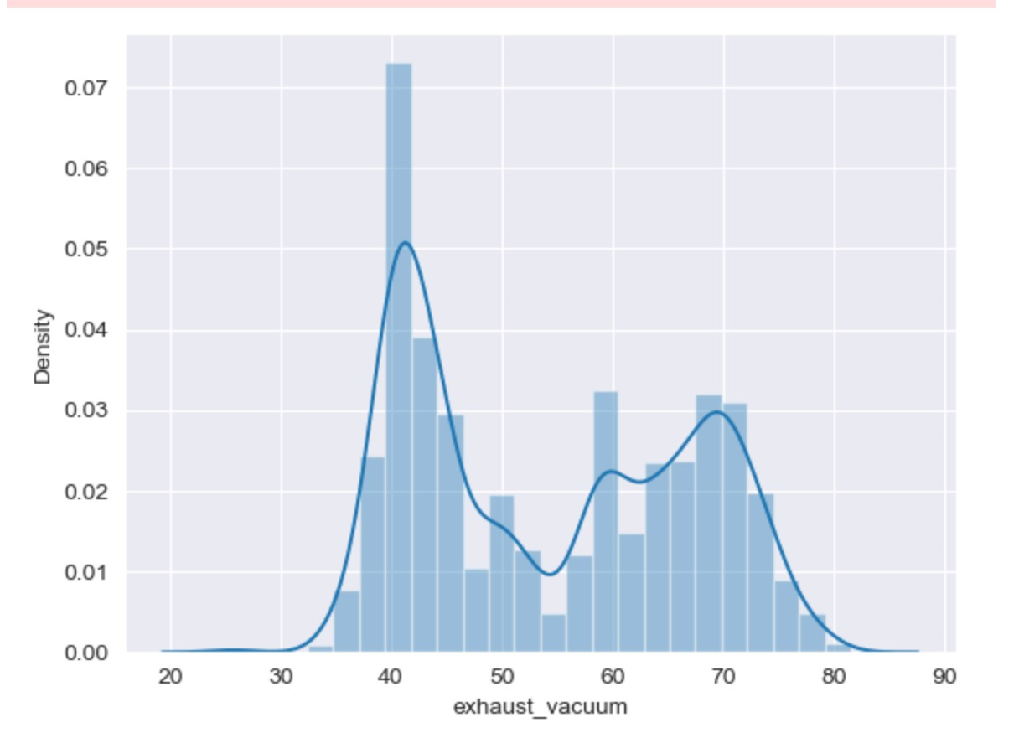
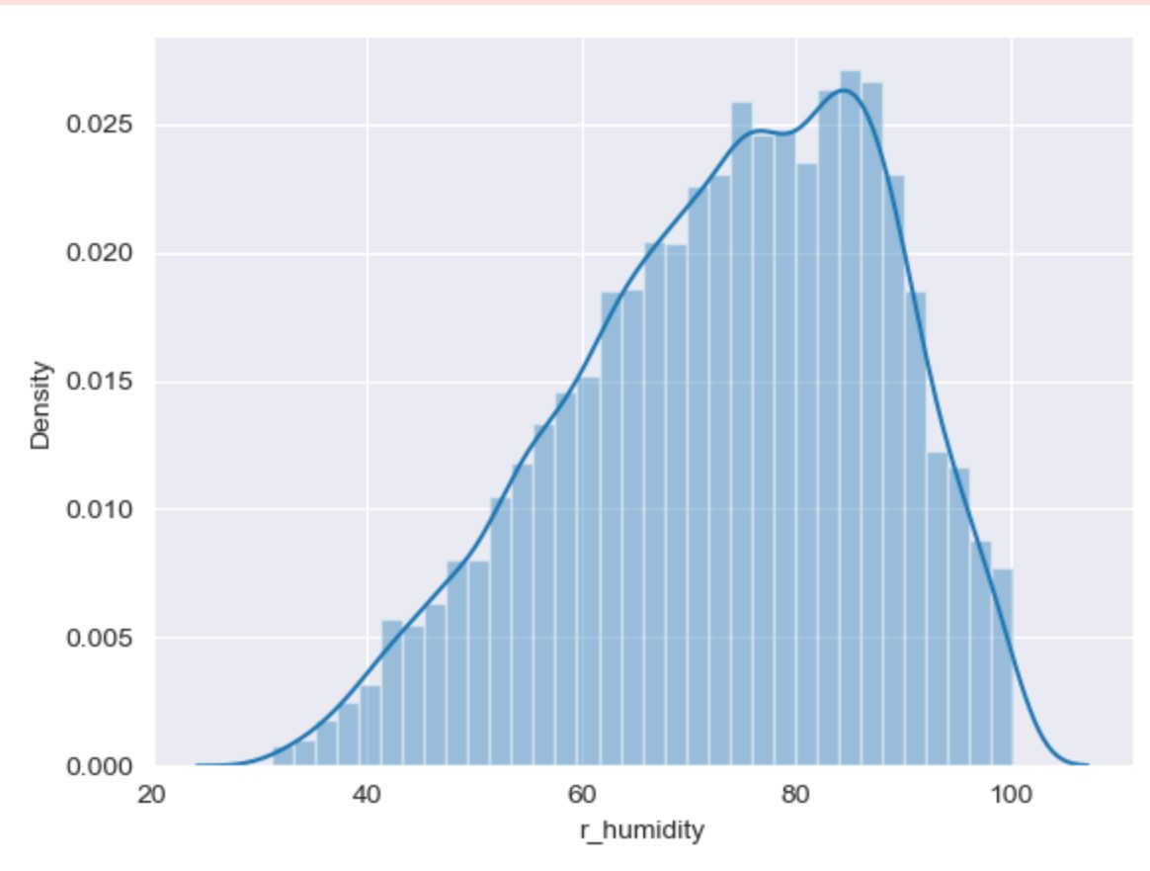
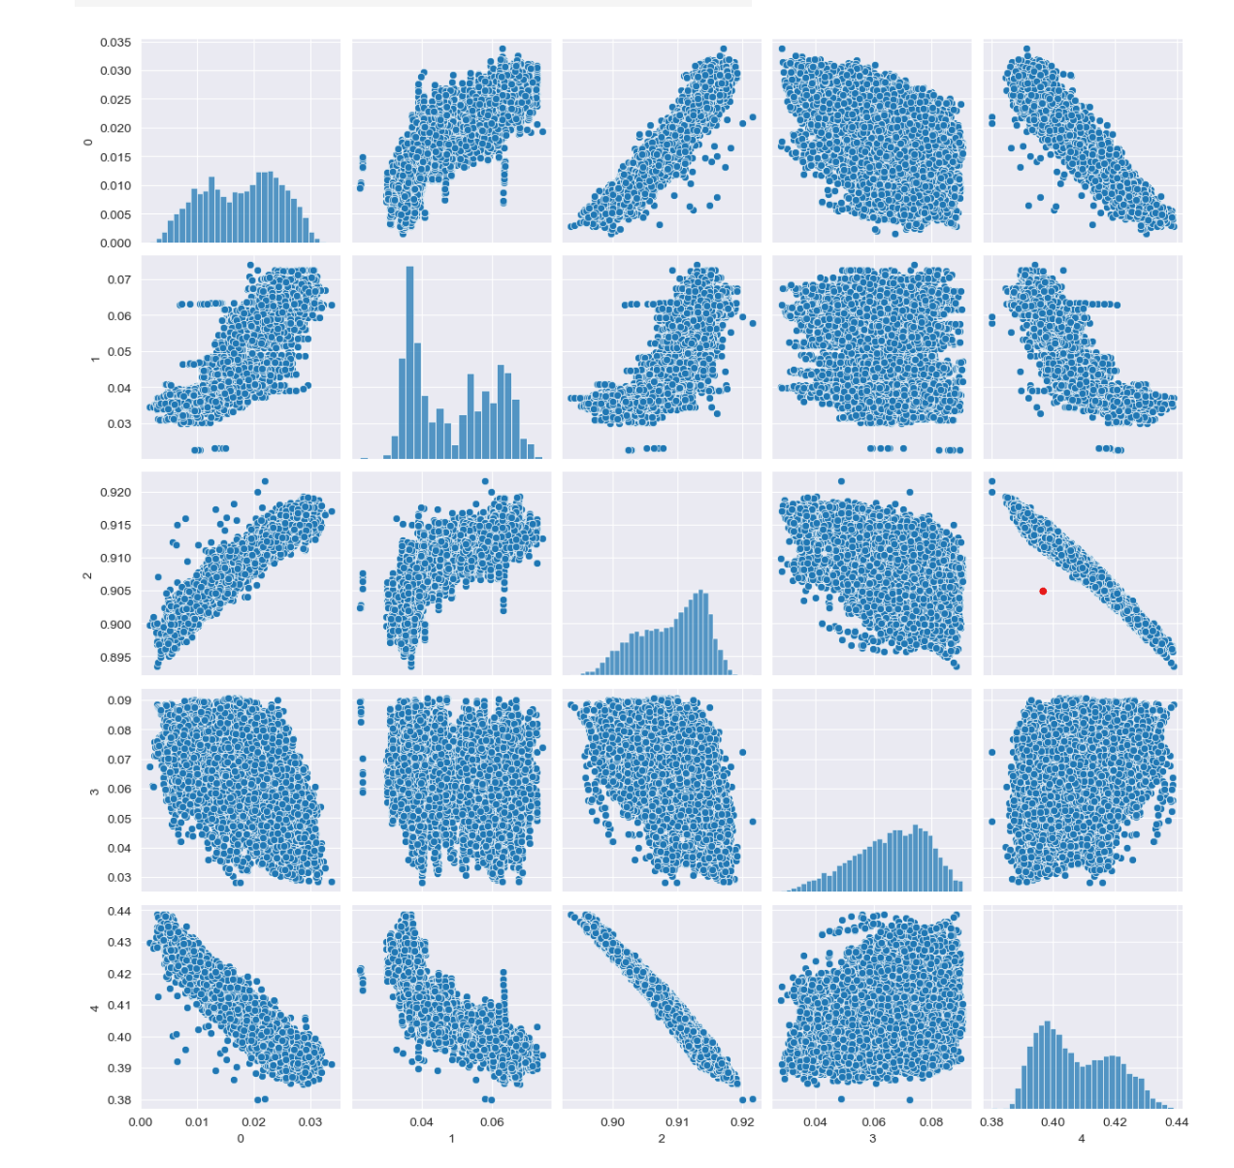
Normal distribution

Slide 13
Normalization:
Splitting the data set:
X is independent variables and Y is dependent variable
Data is splitted in train and test
Train dataset containing 7532 observations and 4 variables.
Test dataset containing 1884 observations and 4 variables.

Slide 14
Feature engineering
The initial observation of the data suggest that we will need to use a linear regression model to predict the power output.
The actual observed value is 481.30, which is not very far from predicted value 480.27
Sklearn library, which provides different machine learning models.
Feature selection:
One of the most important steps in creating a machine learning model is to divide the data set into good predictors to train the algorithm on.

Slide 15
Model building
Linear Regression
Decision tree Regressor
Random forest
Gradient Boosting
Support vector Regressor
XGBOOST
Ridge Regressor
Lasso Regression
KNN Regressor
ADABOOST Regression

Slide 16
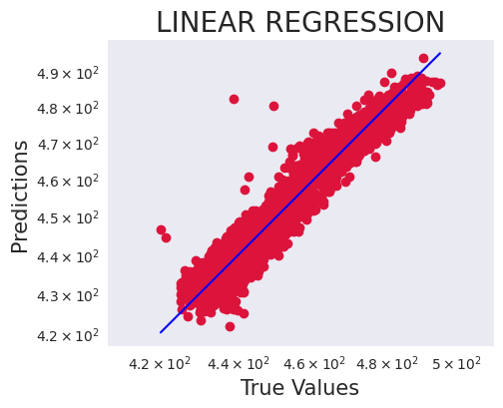
Linear regression
Linear regression is a fundamental statistical and machine learning technique used for modeling the relationship between a dependent variable (also called the target or response variable) and one or more independent variables (predictors or features). It assumes that this relationship can be approximated as a linear equation.
Accuracy of test data: 0.9198969303303213 Accuracy of train data: 0.9307435673202328
Root Mean Squared error(RMSE)4.7083
R-Squared error(R2) 91.5711
Mean Absolute Error(MAE) 3.6875

Slide 17
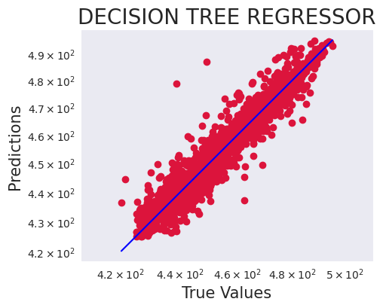
Decision tree regressor
A Decision Tree Regressor is a machine learning algorithm used for regression tasks, which involve predicting continuous numerical values as opposed to categorical classes. It is a specific type of Decision Tree algorithm tailored for regression problems.
Accuracy of test data 0.9248
Accuracy of train data 1.0
Root Mean Squared error(RMSE)4.563
R-Squared error(R2) 92.5953
Mean Absolute Error(MAE) 3.1587

Slide 18
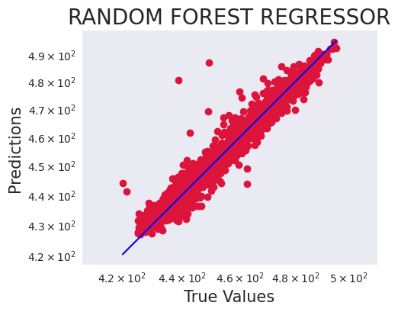
Random forest
Random Forest is a powerful ensemble machine learning algorithm used for both classification and regression tasks. It is known for its high accuracy, robustness, and ability to handle complex datasets. Random Forest belongs to the family of ensemble methods, which means it combines the predictions of multiple base models (decision trees, in this case) to make more accurate and robust predictions.
Accuracy of test data 0.9555
Accuracy of train data 0.9947
Root Mean Squared error(RMSE) 3.51
R-Squared error(R2) 95.4127
Mean Absolute Error(MAE) 2.4322

Slide 19
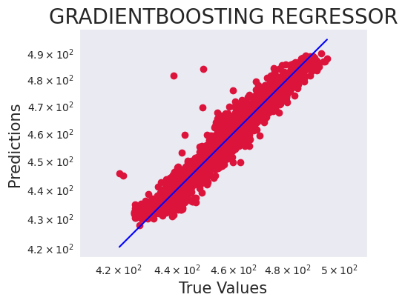
Gradient boosting
Gradient Boosting is a machine learning technique for building predictive models, both for regression and classification tasks. It is an ensemble learning method that combines the predictions of multiple weaker models (typically decision trees) to create a stronger, more accurate model. Gradient Boosting is known for its exceptional predictive power and is widely used in various machine learning applications.
Accuracy of test data 0.9415
Accuracy of train data 0.9544
Root Mean Squared error(RMSE)4.0253
R-Squared error(R2) 93.828
Mean Absolute error(MAE) 3.0174

Slide 20
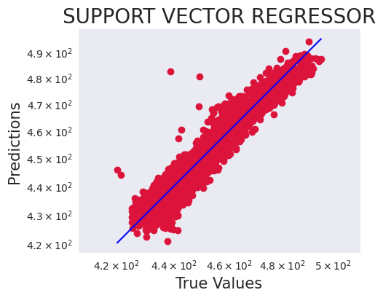
Support vector regressor
A Support Vector Regressor (SVR) is a machine learning algorithm used for regression tasks. It is a variation of the Support Vector Machine (SVM) algorithm, which is primarily used for classification tasks. SVR is designed to predict continuous numerical values rather than classify data into categories.
Accuracy of test data 0.9187
Accuracy of train data 0.9302
Root Mean Squared error(RMSE) 4.7425
R-Squared error(R2) 91.7853
Mean Absolute Error(MAE)3.6946

Slide 21
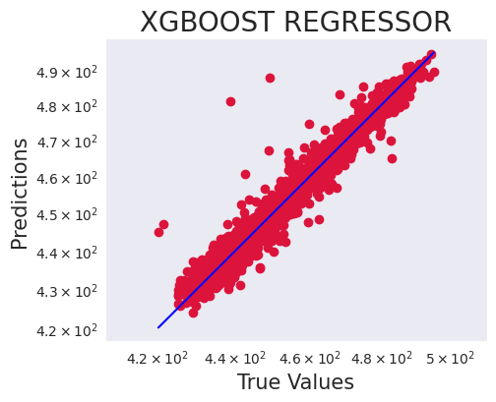
Xgboost
XGBoost (Extreme Gradient Boosting) is a powerful and widely used machine learning algorithm that belongs to the family of ensemble methods. Specifically, XGBoost is an ensemble learning technique based on decision trees. It is known for its exceptional predictive performance and is a popular choice for various machine learning tasks, including both regression and classification.
Accuracy of test data 0.9578
Accuracy of train data 0.9894
Root Mean Squared error(RMSE)3.4192
R-Squared error(R2) 95.6699
Mean Absolute Error(MAE) 2.3088

Slide 22

Ridge regressor
Ridge Regression, also known as L2 regularization, is a linear regression technique used for both regression and classification tasks. It is a regularization method that is used to prevent overfitting and improve the stability of the linear regression model, especially when dealing with multicollinearity (high correlation between features) in the dataset.
Accuracy of test data 0.9199
Accuracy of train data 0.9307
Root Mean Squared error(RMSE)4.7083
R-Squared error(R2) 91.5711
Mean Absolute Error(MAE) 3.6875

Slide 23
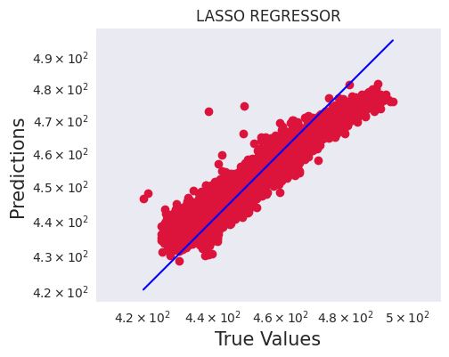
Lasso regression
Lasso Regression, short for "Least Absolute Shrinkage and Selection Operator" Regression, is a linear regression technique used for both regression and feature selection tasks. Like Ridge Regression, Lasso Regression is a regularization method that is used to prevent overfitting and improve the stability of linear regression models.
Accuracy of test data 0.8549
Accuracy of train data 0.8594
Root Mean Squared error(RMSE) 6.3375
R-Squared error(R2) 72.689
Mean Absolute Error(MAE) 5.1567

Slide 24
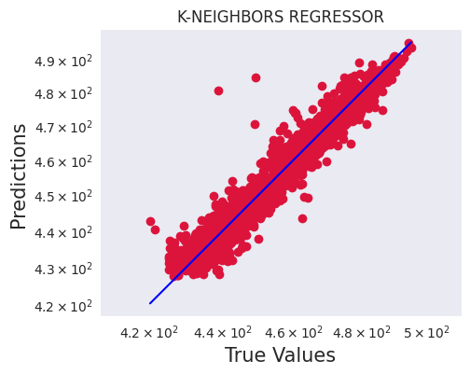
KNN regressor
K-Nearest Neighbors Regressor (KNN Regressor) is a supervised machine learning algorithm used for regression tasks. Unlike traditional regression methods that fit a mathematical function to the data, KNN Regressor makes predictions by finding the K nearest data points (neighbors) to a given input data point and averaging their target values. It is an instance-based or lazy learning algorithm because it doesn't build a model during training but rather memorizes the training data.
Accuracy of test data 0.945
Accuracy of train data 0.9694
Root Mean Squared error 3.9004
R-Squared error(R2) 94.3703
Mean Absolute error(MAE)2.7866

Slide 25
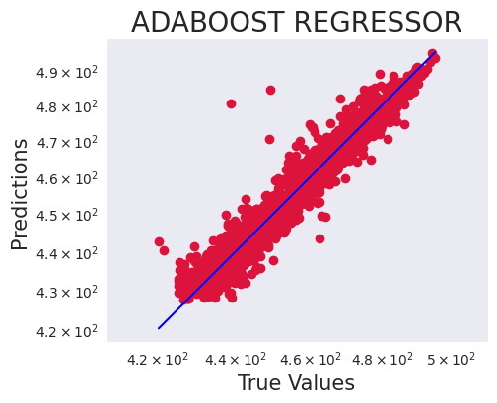
ADABOOST regression
AdaBoost (Adaptive Boosting) is primarily used as an ensemble learning method for classification tasks, and its most common variant, AdaBoost Classifier, is designed for classification. However, AdaBoost can also be adapted for regression tasks, in which case it is referred to as AdaBoost Regressor. In this response, I'll focus on AdaBoost Regressor.
Accuracy of test data 0.9579
Accuracy of test data 0.9999
Root Mean Squared error(RMSE)0.0086
R-Squared error(R2) 94.3703
Mean Absolute Error(MAE) 2.7866

Slide 26
Model evaluation
For Regression problems, there are 3 key performance metrics that are used to assess how well your model is performing.
Root Mean Squared Error (RMSE): measures the average error performed by the model in predicting the outcome for an observation(value should be low for high accuracy of model).
R-Squared: It means how much of the variation in the target variable that can be explained by the set of features used in training the model.
Mean Absolute Error: measures how far predicted values are away from the actual values.

Slide 27
Performance metrics
 | Model | RMSE | R2SCORES | MAE | RMSLE | MSE
 | XGB_Regressor | 3.419237 | 95.669925 | 2.308823 | 0.007519 | 11.691180
 | RandomForest_Regressor | 3.510005 | 95.412670 | 2.432175 | 0.007715 | 12.320135
 | KNeighbors_Regressor | 3.900438 | 94.370265 | 2.786614 | 0.008596 | 15.213415
 | AdaBoost_Regressor | 3.900438 | 94.370265 | 2.786614 | 0.008596 | 15.213415
 | LogisticRegression | 3.900438 | 94.370265 | 2.786614 | 0.008596 | 2.786614
 | Gradientboosting_regressor | 4.025290 | 93.827740 | 3.017459 | 0.008843 | 16.202963
 | DecisionTree_Regressor | 4.562994 | 92.595296 | 3.158725 | 0.010029 | 20.820910
 | Ridge_regressor | 4.708339 | 91.571136 | 3.687528 | 0.010381 | 22.168453
 | LinearRegression | 4.708341 | 91.571148 | 3.687528 | 0.010381 | 22.168471
 | supportvector_regressor | 4.742523 | 91.785314 | 3.694628 | 0.010473 | 22.491528
 | Lasso_regressor | 6.337475 | 72.688999 | 5.156697 | 0.013857 | 40.163587

Slide 28
Since RMSE of Randomforest regressor that is, 3.51 and r-squared error is 95.41 so, we will finalise Randomforest_regressor.

Slide 29
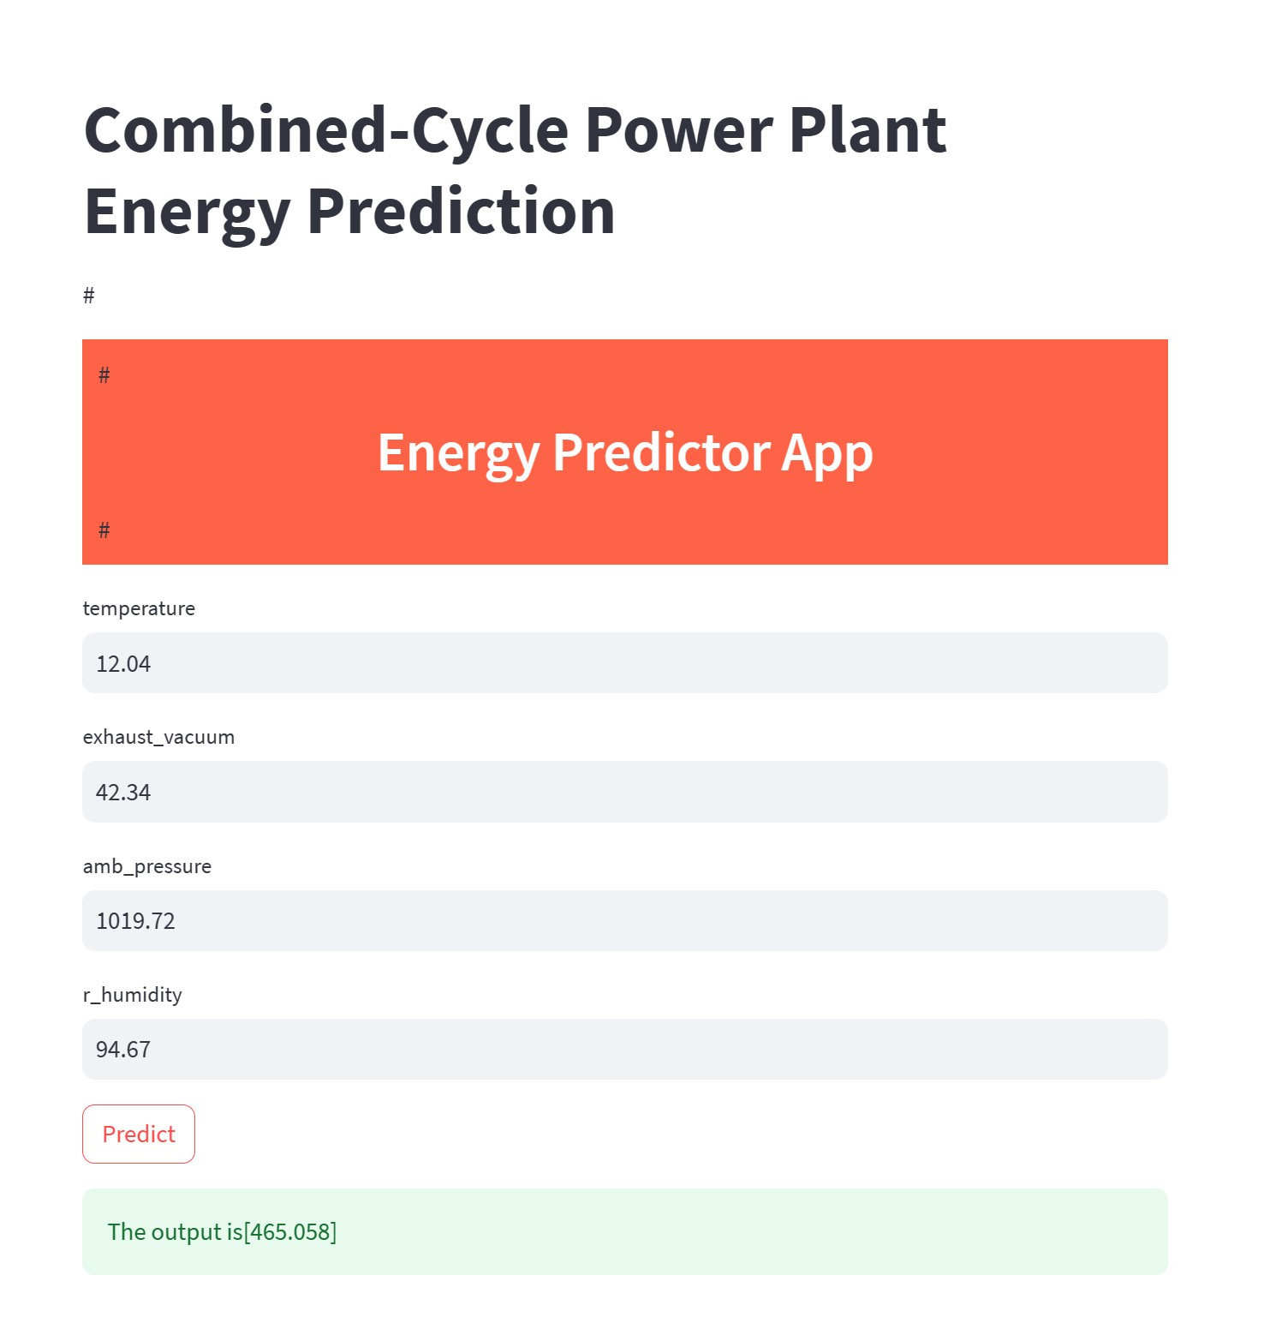
Deployment of Model

Slide 30
Challenges Faced
Trying to understand about the data of the energy production.
Outliers can negatively effect the performance of machine learning models by introducing noise or causing issues in the model performance.
When trying to run the algorithms in the hyper parameter tunning it takes lot of time to process. also when we do the cross validation it takes time to process.
Deciding which regression algorithm to use for predicting energy production was a challenging task.

Slide 31
Thank you

